Slide 1
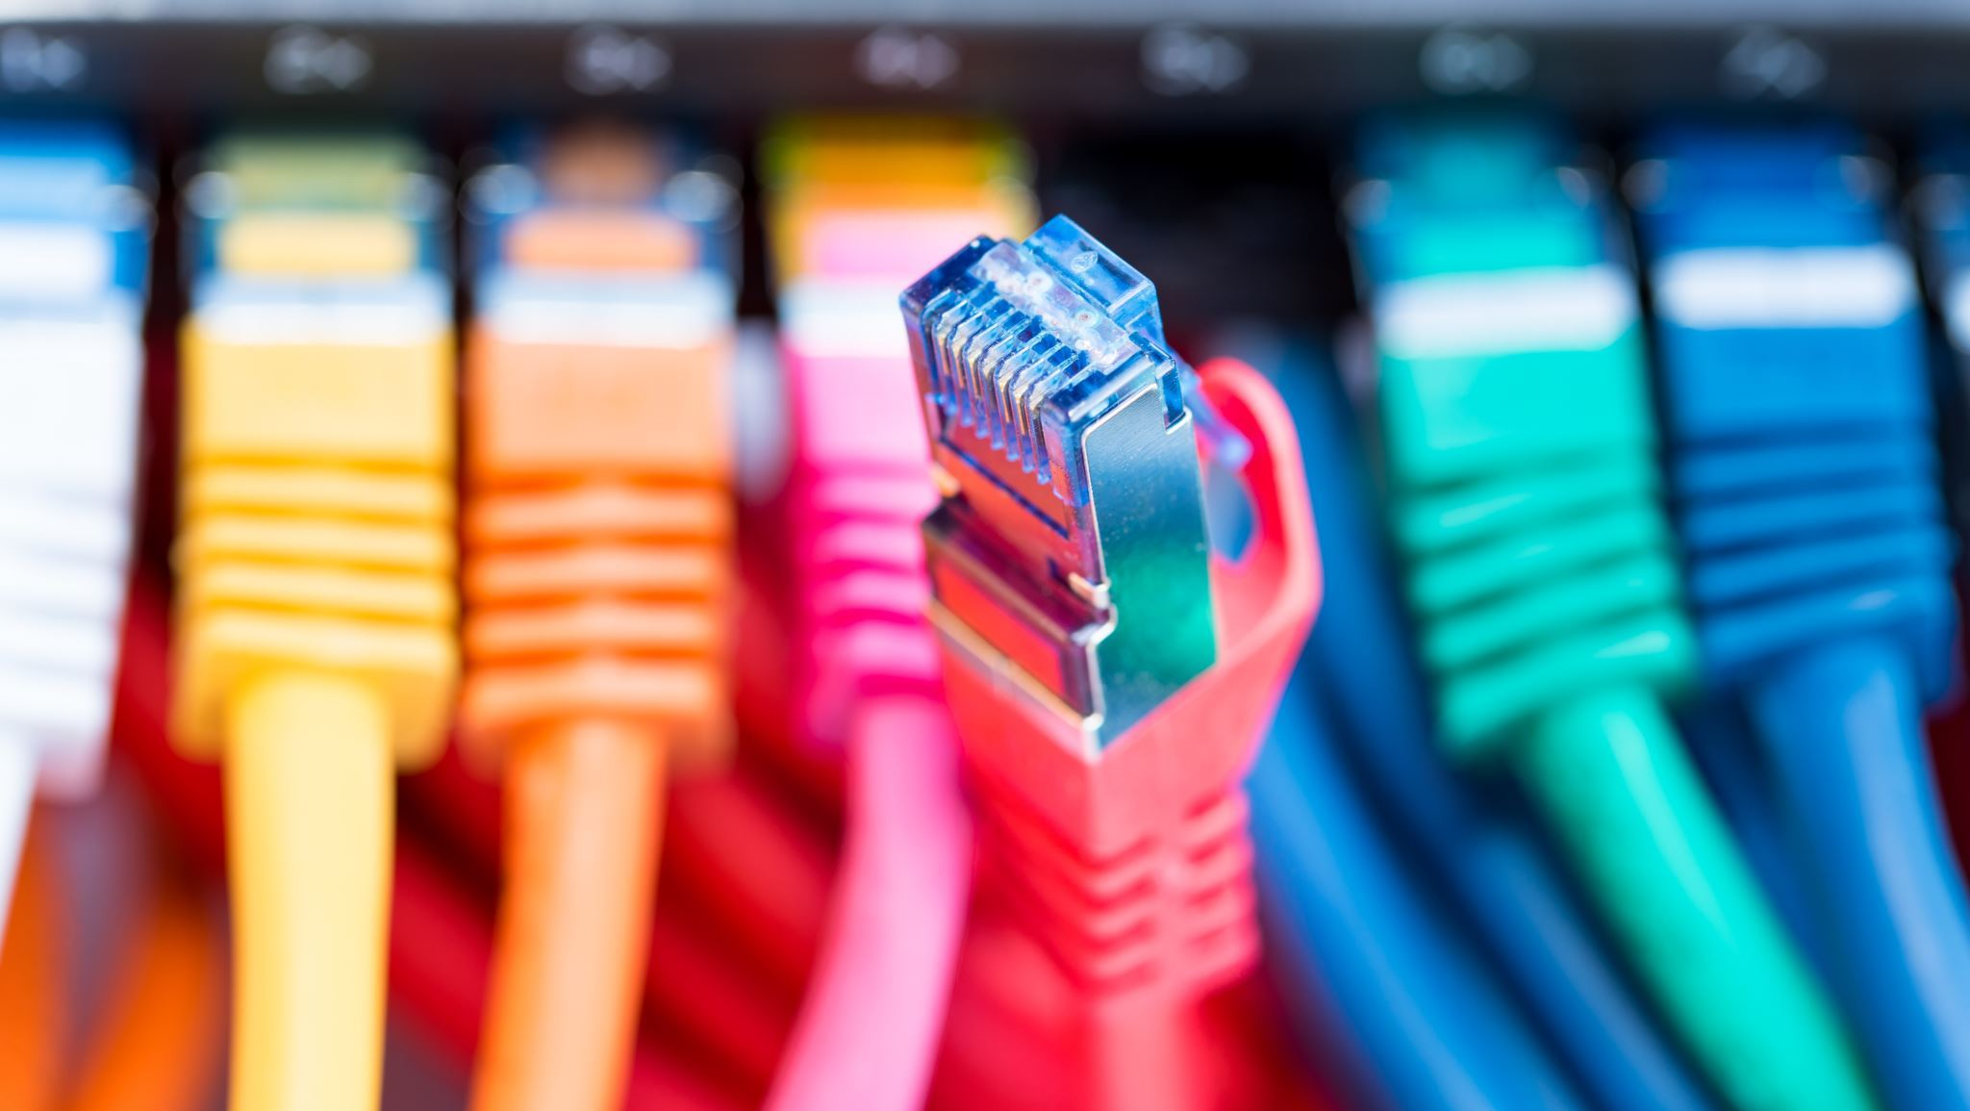
Low-Cost Optical Communications System
By: Team 3 (Cameron Martinez, Sean Huber, Matthew Simms, Dylan Koch, Dominic Steiner, Jarrod Siglin)

Slide 2
Why Optical Communications?
Near infra-red frequencies (750-1600 nm)
Demand for RF spectrum is outstripping supply
New frequency bands needed
Benefits:
High data transmission rate (over 100 Gbps)
Less power consumption than radio, microwave and other similar technologies
Small/light physical design
Considered emerging technology by NASA and other aerospace companies
More research will lead to decrease in cost and application difficulty
Notes:
Optical Communications is a relatively new technology that allows for rapid, high-bandwidth wireless transmission of data across nearly any distance.
This technology can transfer data at rates much faster than radio, microwave, or other contemporary technologies (over 100Gbps), all the while using less power, a smaller payload size, and an overall smaller/lighter physical design.
Researching and developing Optical Communication Systems will benefit multiple industries, especially the Aerospace Industry, as transmissions across the solar system would require less power and time to receive the same amount of information compared to a different transmission style.
Proliferation of this technology would lead to a decrease in cost and difficulty in application; can have positive impacts for other industries that already require fast, wireless transfer of data.

Slide 3
Design Considerations
Cost
System shall cost under $2000 USD.
System shall use commercial-off-the-shelf (COTS) components.
Hardware
System shall use a 1550 nm wavelength laser diode (NIR-C class).
System shall be remotely operated via a SSH server/client connection.
System shall operate across free space.
Software
System shall use the OpenCV and Base64 libraries, for encoding and decoding the video feed.
System shall use Python3 for all software implementation.
System shall use On-Off Keying (OOK) for modulation.
Notes:
Design Considerations o Assumptions, dependencies o General Constraints o Industrial Standards Followed (if there are any) o Safety constraints and considerations o Other

Slide 4
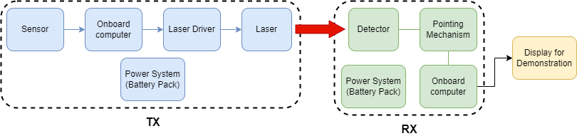
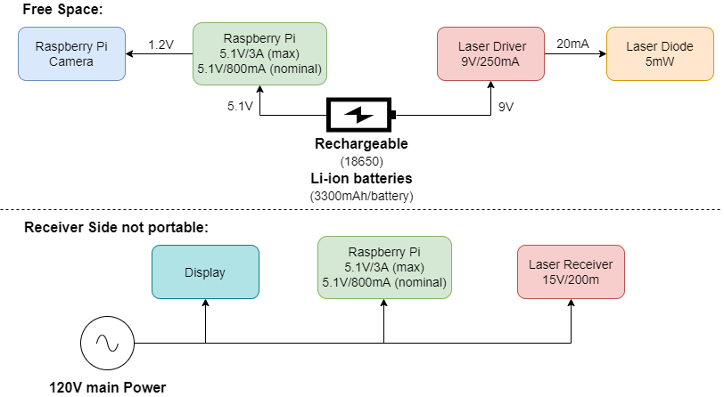
System Architecture and Design

Slide 5
Software
Code External Requirements:
Python 3.11.2
CV2 4.1.2.30
Numpy 1.23.5
PiCamera 1.13
Flask 2.2
Base64
Future goals:
Watchdog to prevent unrecoverable transmission errors
Higher frame rate to translate the image string to an MJPEG stream
User friendly GUI or web-based usage
Speeds Achieved:
Through Wire: 921600 Baud or 92.60 KBs
Through Free Space: 19200 Baud or 1.92 KBs

Slide 6
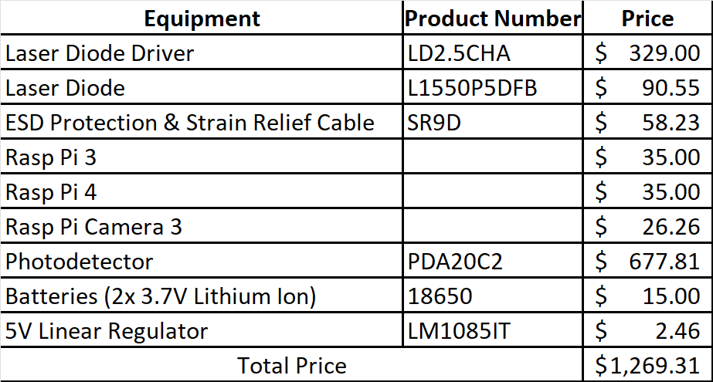
System Price Breakdown

Slide 7
Final Sprint Progress
Planned Final Sprint:
Integrate camera to transmitter and a visual display to receiver.
Implement power sub-system.
Use Rasp Pi to modulate driver signal.
Create and define resource guide for future users.
Actual Final Sprint:
Completed User Manual
Integrated camera to transmitter and a visual display to receiver.
Implemented power sub-system.
Used Rasp Pi to modulate driver signal.

Slide 8
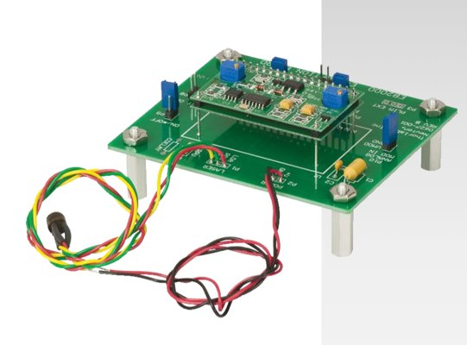
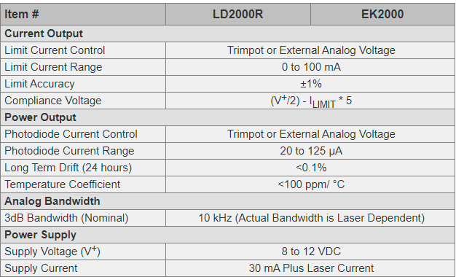
Previous Group's Laser Driver
Previous Group's Driver
Ek2000 – ThorLabs
Constant Power Mode from 20 μA to 125 μA
Laser Drive Currents from 0 to 100 mA
Ultra-Stable Laser Control
On Board Trimpots are Provided for Controlling the Laser Power and Current Limit
Slow Start for Diode Protection
Modulation Bandwidth DC – 10 kHz

Slide 9
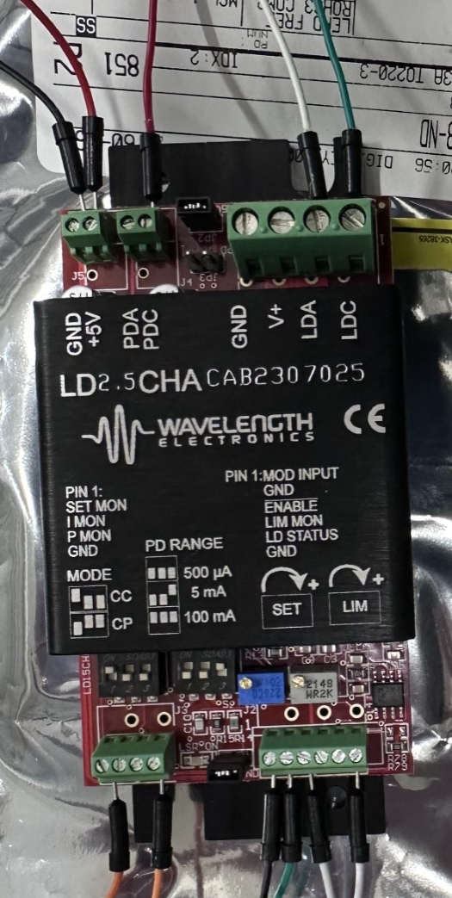
New Laser Driver
LD2.5CHA 2.5 A / 30 V Laser Diode Driver
Control Electronics: -2.5V-+5 V
Laser Supply: +5 to +30 V
Compliance Voltage: 3 V with 5 VDC power supply; 28 V with 30 VDC power supply
Maximum Output Current: 2.5 A
3dB Modulation Bandwidth: 1 MHz
Package size: 1.125″ x 2.1″ x 4.5″ (28.6 x 53.3 x 114.3 mm)

Slide 10
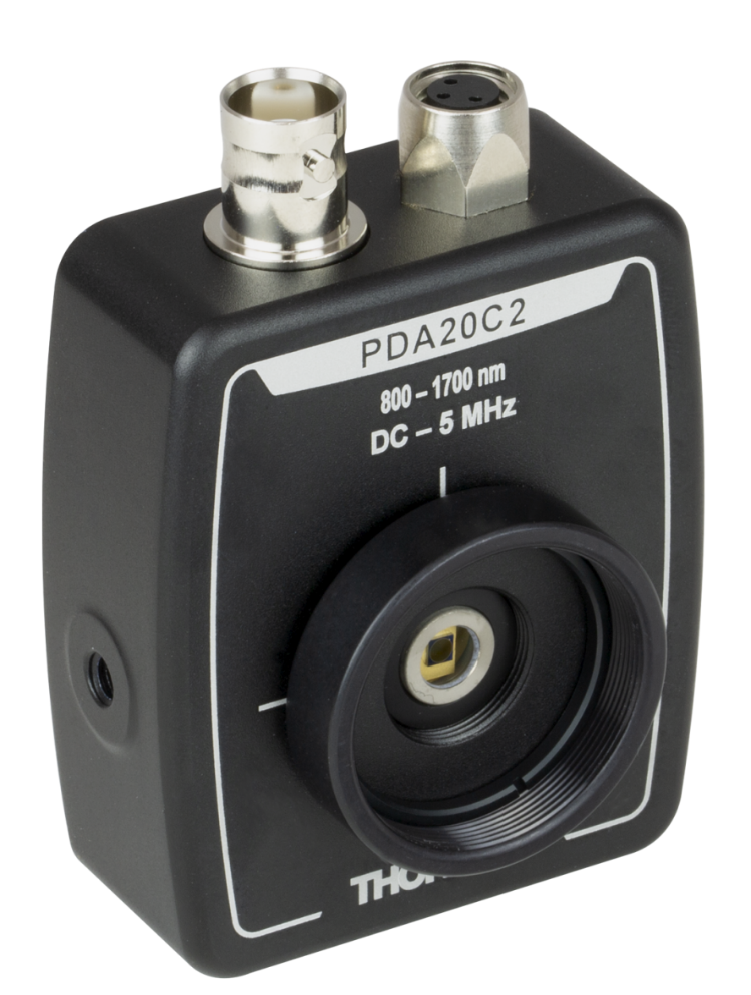
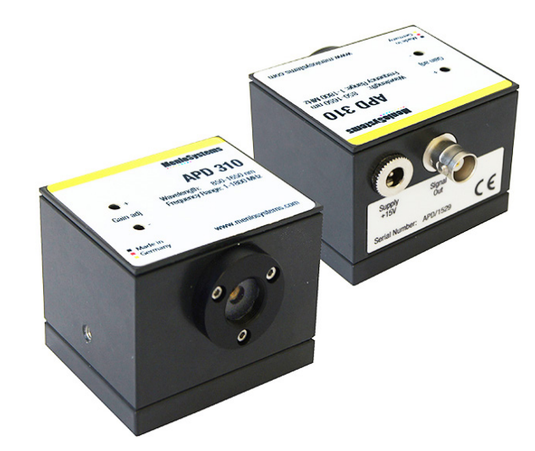
Photodetector
Previous Group's Sensor
APD310 – ThorLabs
850-1650 nm
Variable static gain
Output: 1V Maximum
Detector diameter: 0.04 mm
Increased sensitivity
$2,893.29
Bandwidth 1MHz - 1600MHz
New Sensor
PDA20C2 – ThorLabs
800-1700 nm
Built in gain
Output: 3.5V Maximum
Detector diameter: 2.0 mm
$677.81
Bandwidth 0-5MHz

Slide 11
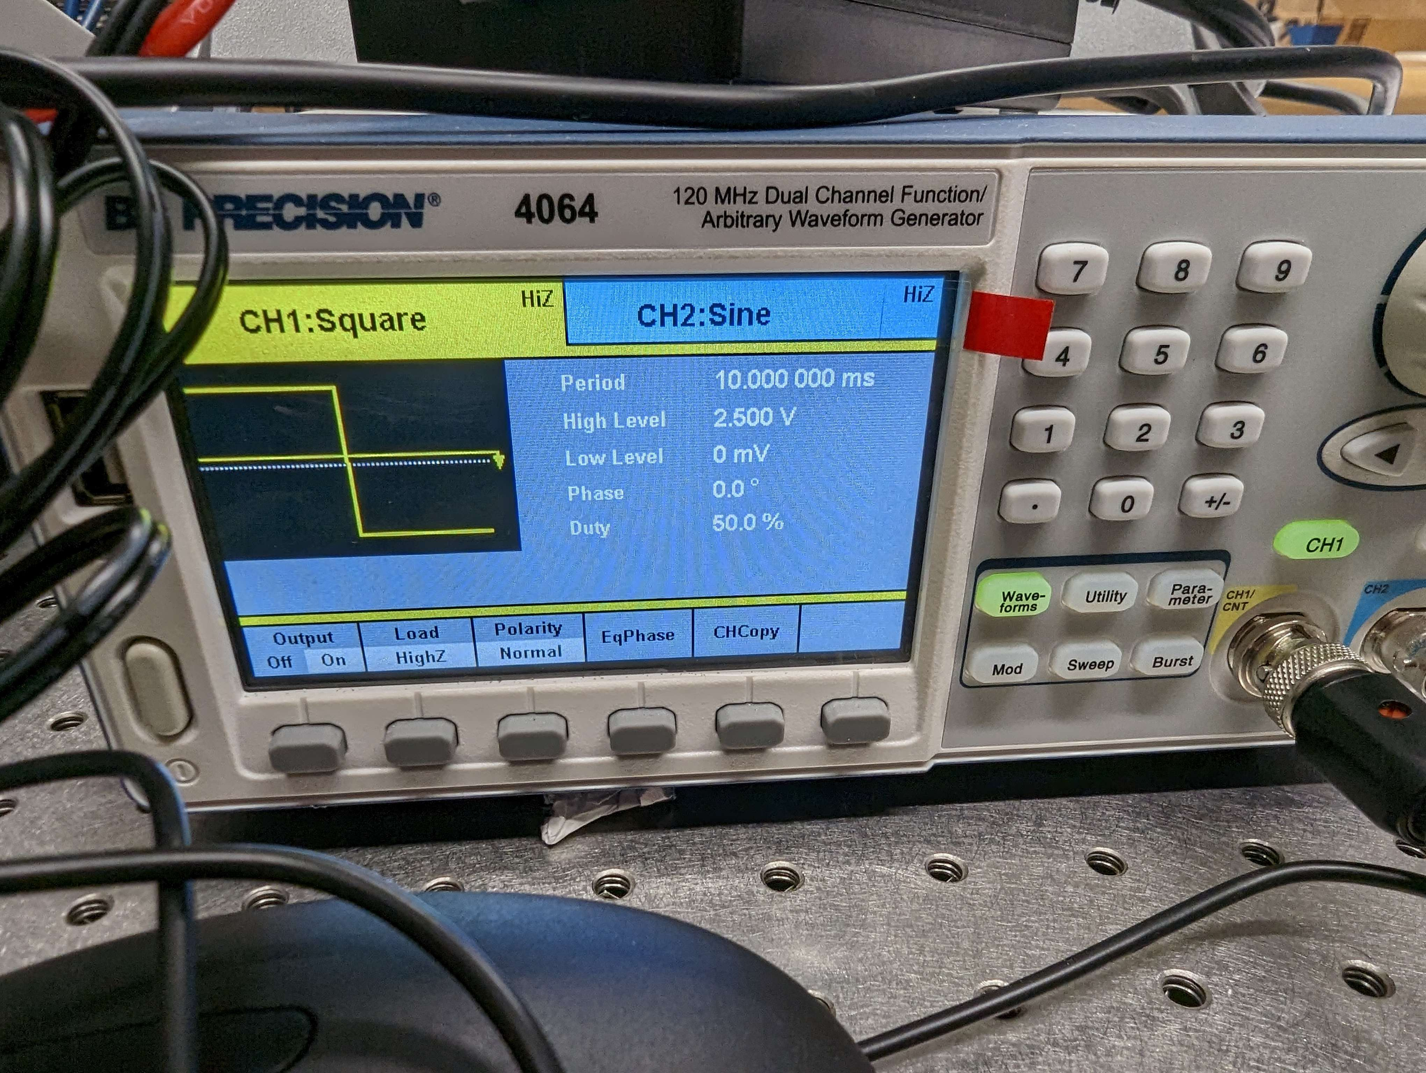
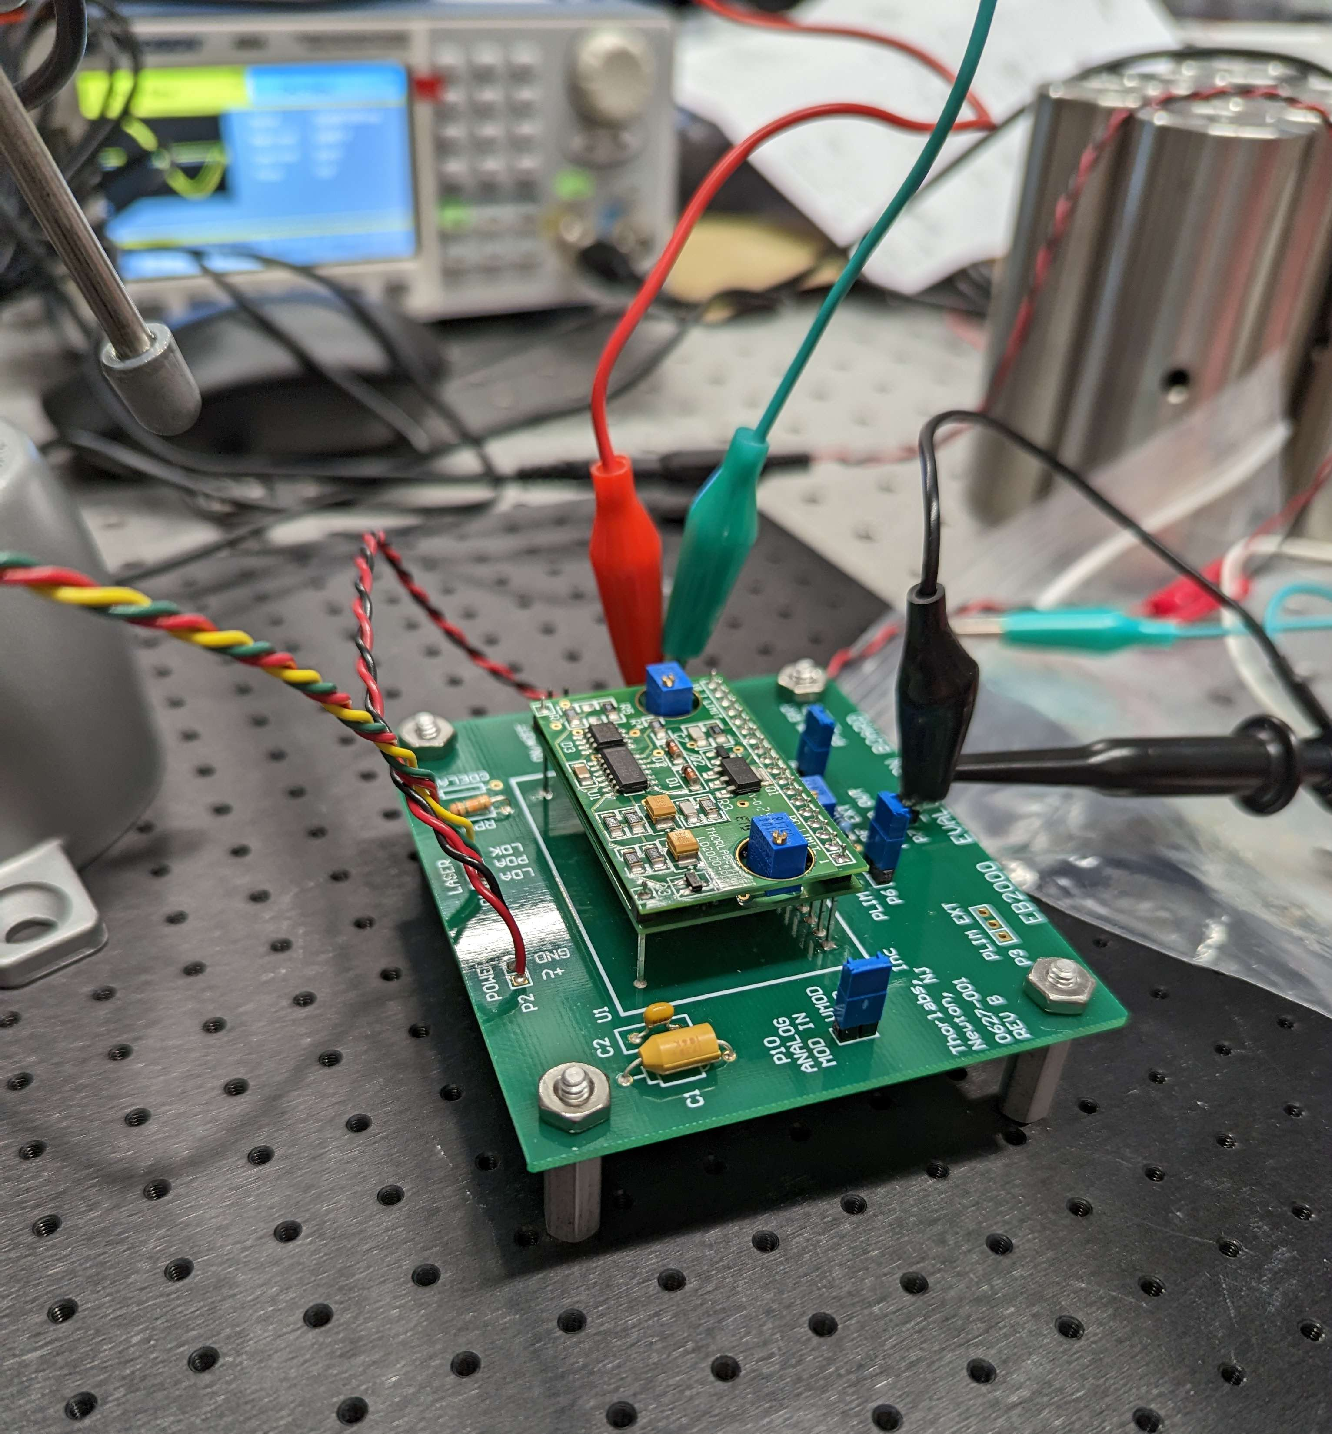
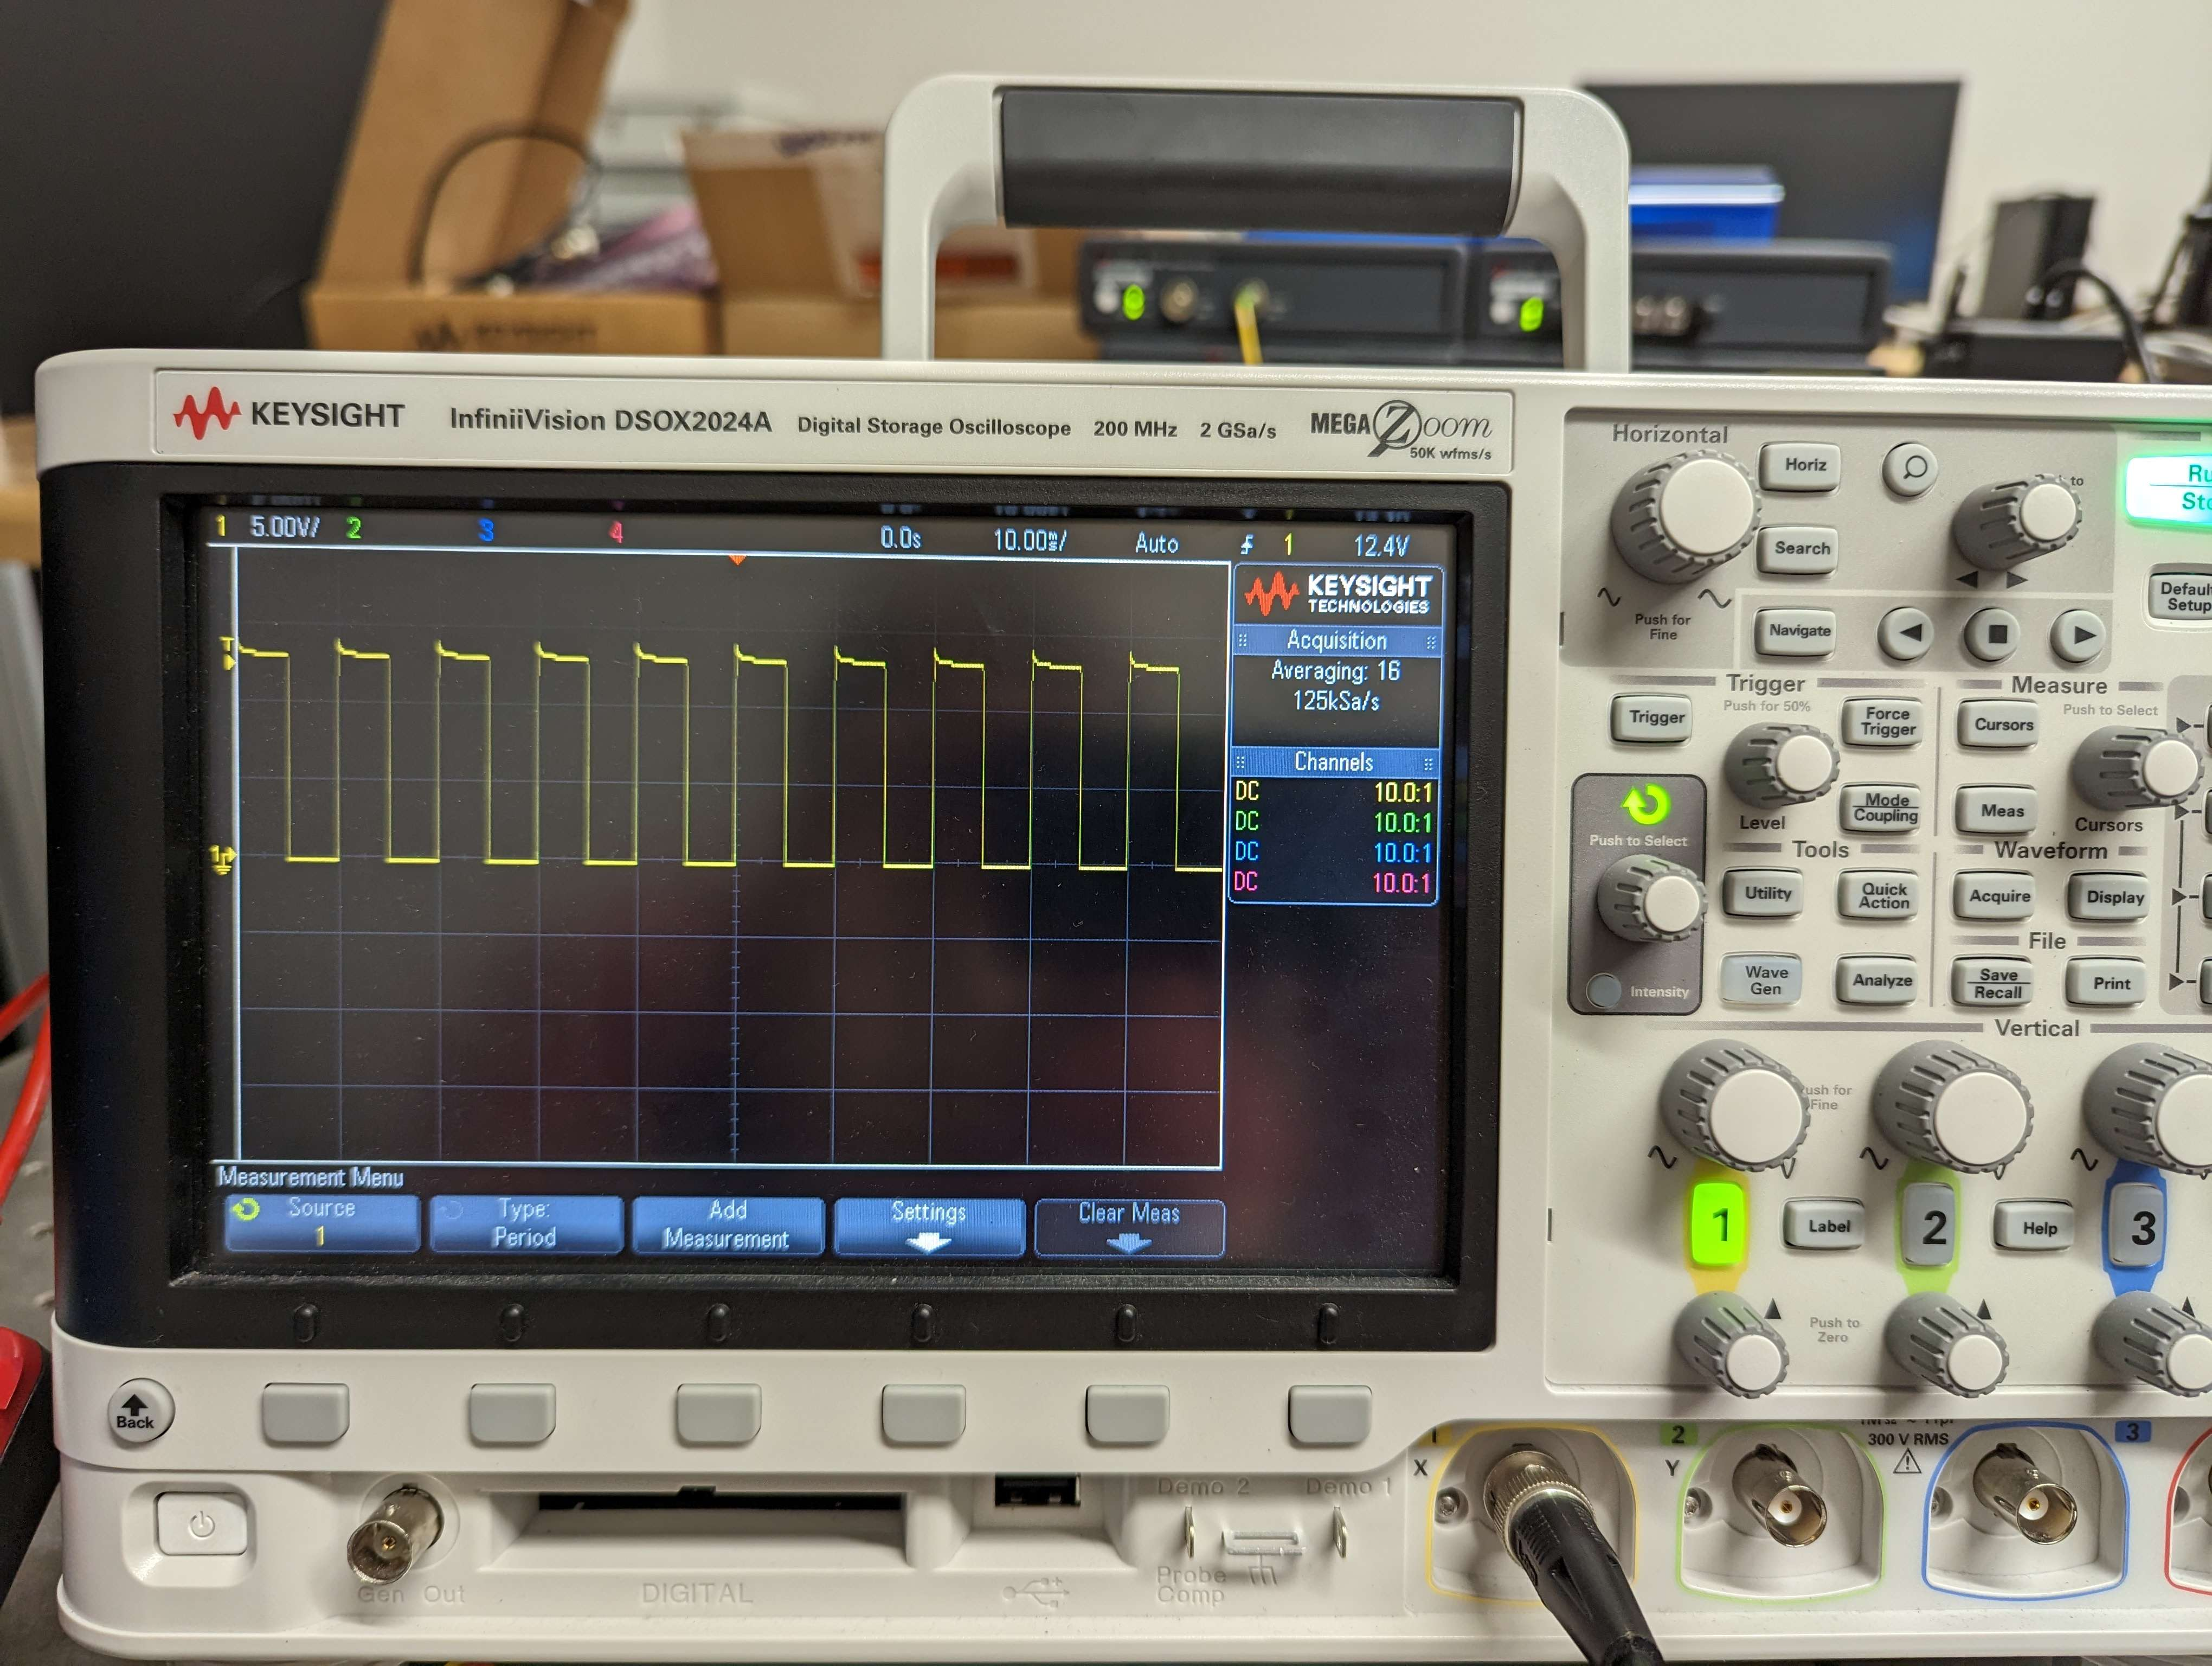
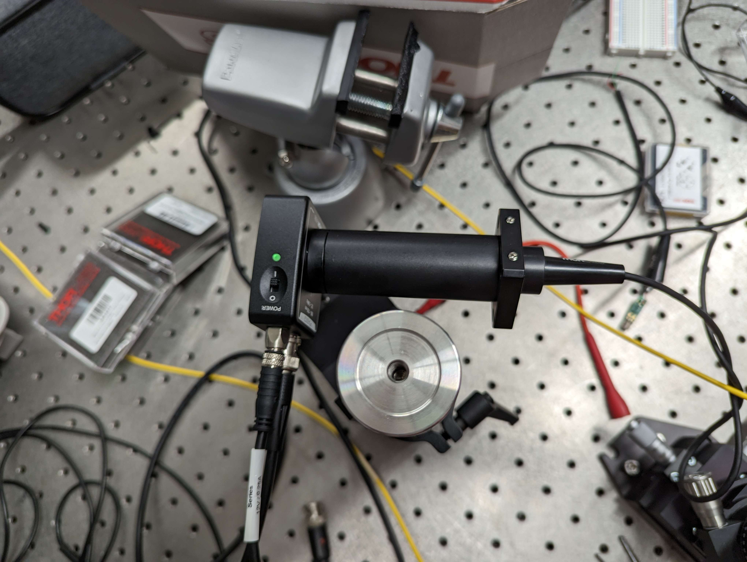
Previous Setup

Slide 12
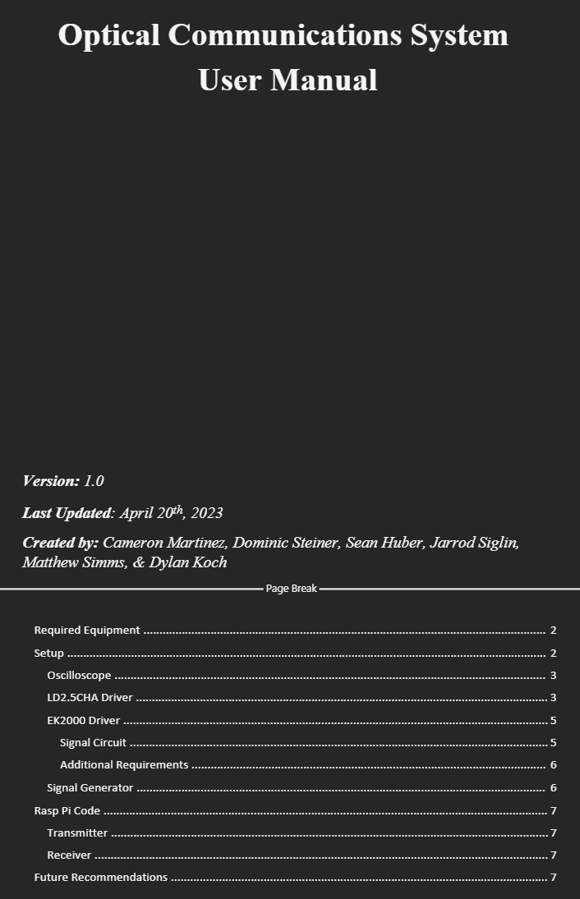
User Manual
Established step by step operation of equipment
Laid out safety and operational limitations
Future recommendations for aspects of the project

Slide 13
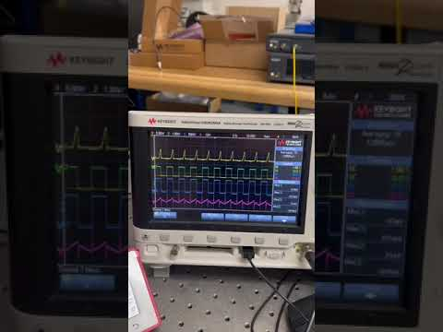
Signal and Current Measurements

Slide 14
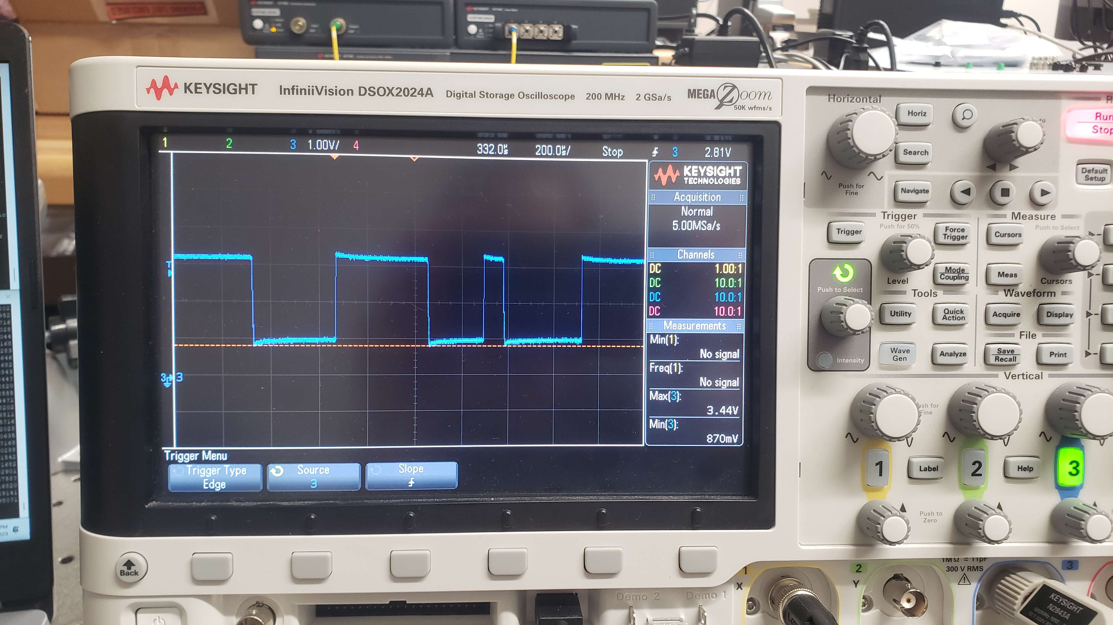
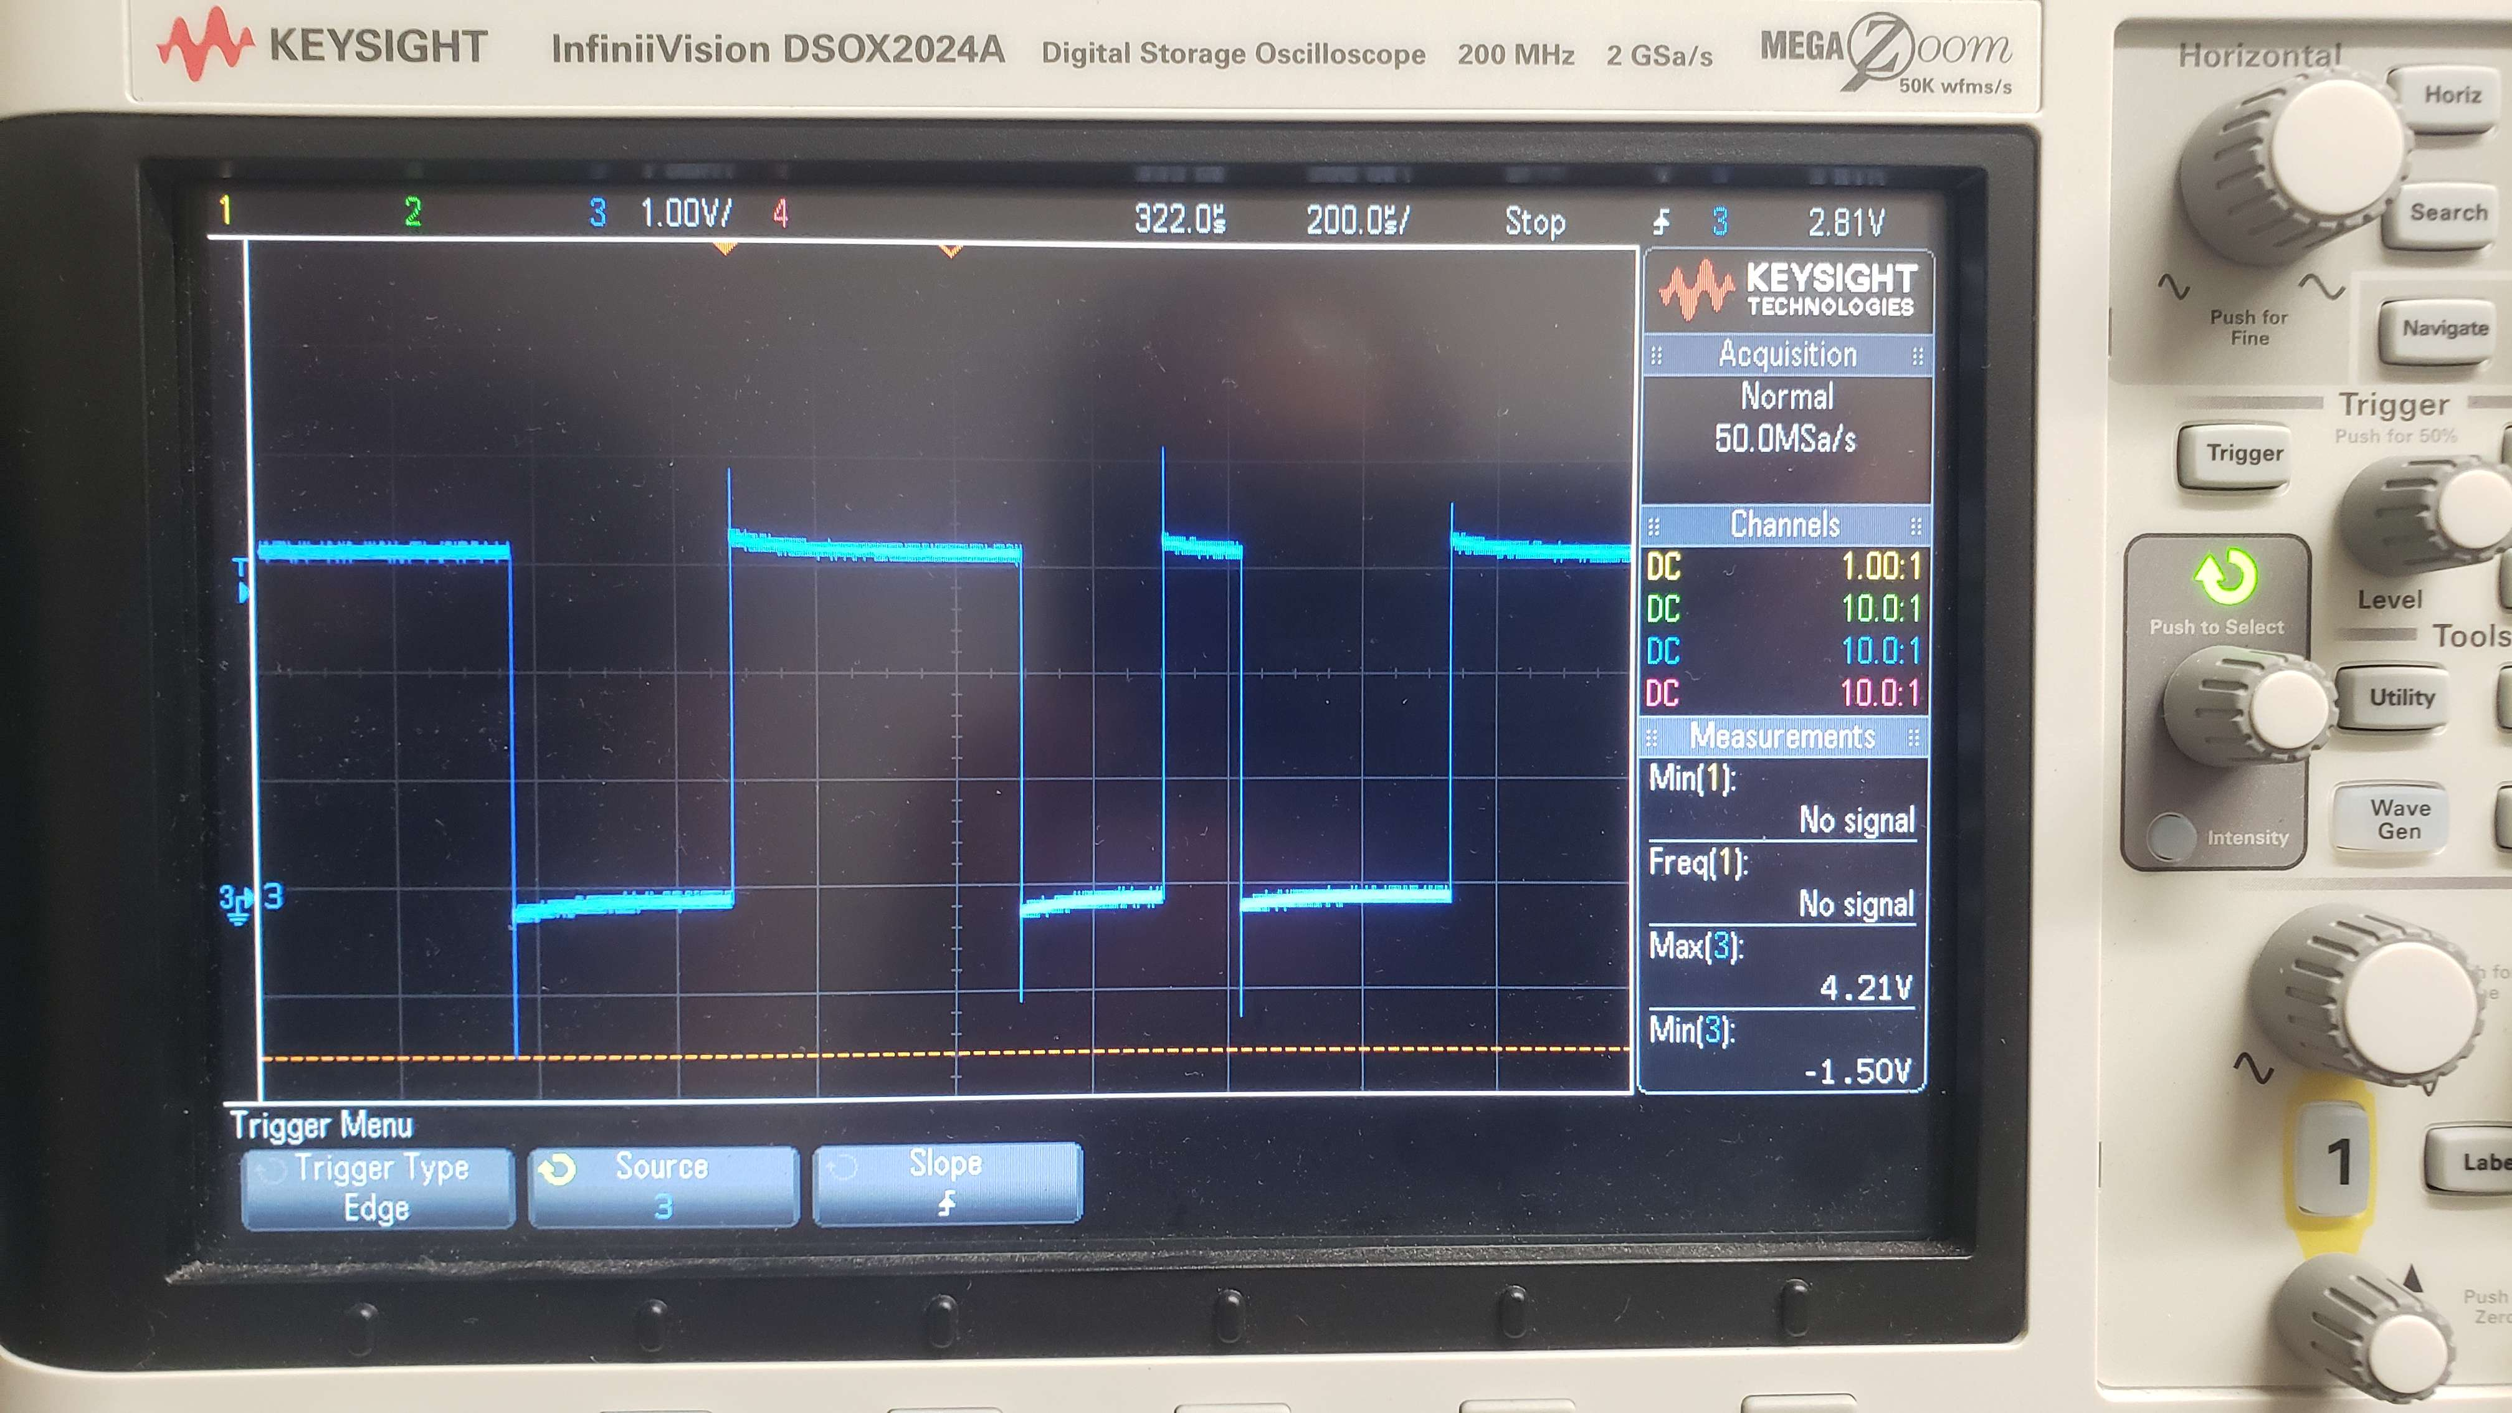
Time Drift
Receiver RasPi Signal
Transmitter RasPi Signal

Slide 15
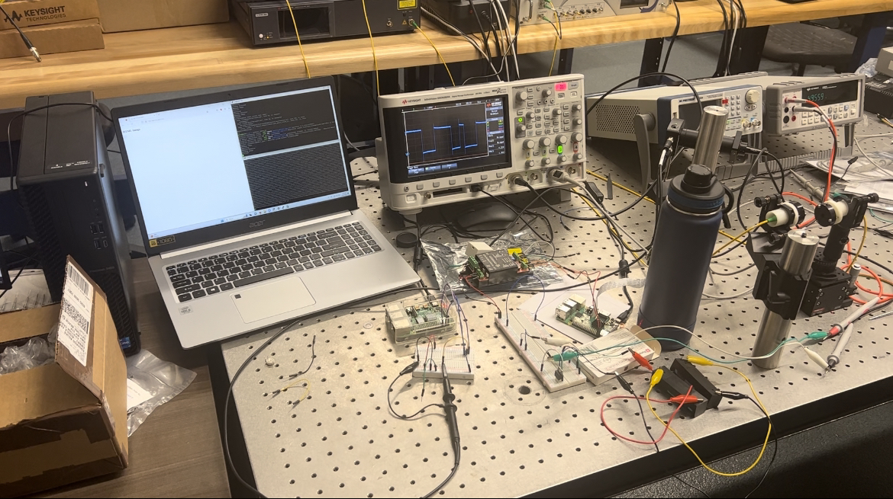
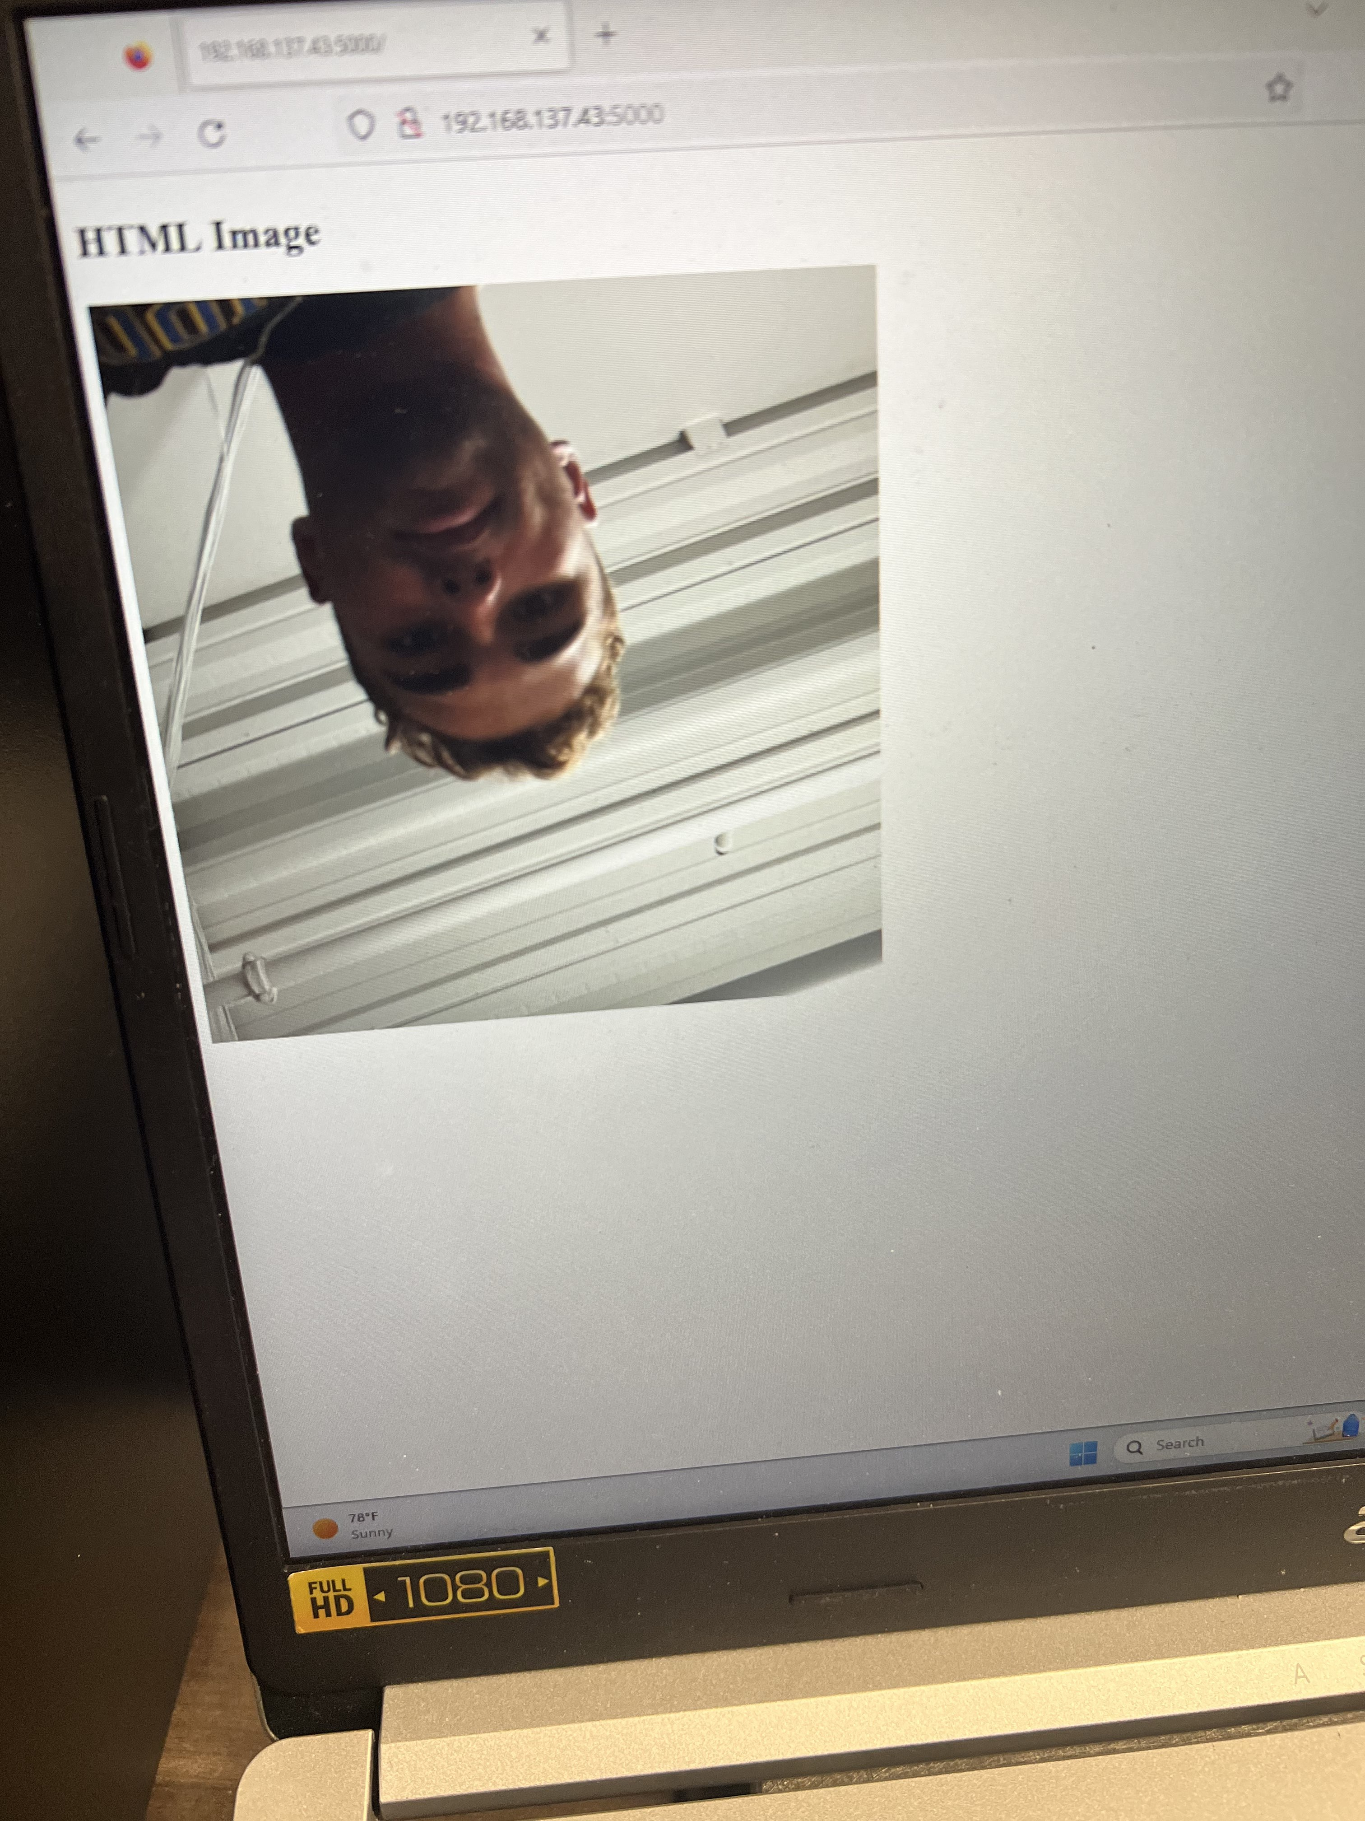
Laser Driver Transmission
Current Video Specification:
Colored 480x480
Image every 50 seconds.
Complete System Setup
Optically Transmitted Image

Slide 16
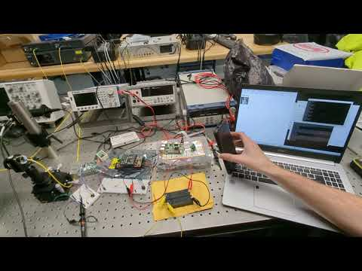
Laser Driver Transmission

Slide 17
Project Takeaways
Know operating limitations of each piece of equipment
Perform research of components and setup
Provide user manual for future teams
Time management

Slide 18
Recommendations
Adding a scan function to align receiver and transmitter.
Extending the distance of transmission.
Transmitting a full video feed and increasing transmission rate.
Modify receiver side display and add save function.
Create package for receiver and transmitter.

Slide 19
Questions?
Ask away!

